Slide 1



Introduction to JavaScript ES6
Mark J. Buckler
OCPJP,CIWJS

Slide 2

Credits
Some of the contents of this slide presentation have been referenced and reproduced, from Switching to ES6 in Node.js, by Ryan Lewis, ©2017 LinkedIn Corporation.

Slide 3
LEARNING OBJECTIVES
Introducing JavaScript ES6
Functions in ES6
Lexical Scope in JavaScript
Default Function Parameters
Ellipsis Operator
Introducing Classes

Slide 4
Introducing JavaScript ES6
What is ES6
A JavaScript specification created by ECMA International
European Computer Manufacturers Association
The standards body for JavaScript since 1996
ES6 = ECMAScript 6 = ES2015
Specification completed mid-2015
Implementation
Was planned to be completed by all browser vendors

Slide 5
Introducing JavaScript ES6
V8 JavaScript Engine
Built by Google and used in the Chrome browser
Achieved complete support for ES6 in mid-2016
Used in Node.js as the JavaScript engine
Not all browsers fully support ES6 yet
Therefore, front-end JavaScript code must often be transpiled
Not true of back-end code for Node.js versions 6 and later

Slide 6
Introducing JavaScript ES6
Transpiling ES6
The process of turning ES6 code into ES5 code so it can be read by all browsers
Not all browsers support all of ES6, but Chrome supports the most
Because Chrome V8 Engine is used in Node.js
We should always transpile because end-user browser cannot be predicted
The most popular transpiler is Babel
There are others: Traceur, Closure, JSX, TypeScript
Babel supports the most ES6 specification features
We will study this later, let’s start back-end with node

Slide 7
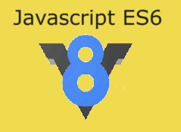
Introducing JavaScript ES6
Programming Exercise03_01_01 – Step 1
Setting up the Project

Slide 8
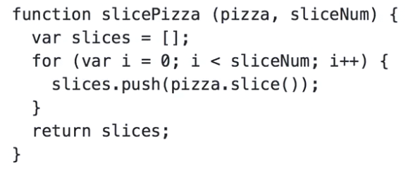
Functions in ES6
Arrow Functions
The function keyword is still valid
Arrow function syntax has been introduced
Cleans up function syntax very nicely and concisely
Also changes some of the properties of functions
Normal function syntax is not too painful in standalone function declarations

Slide 9
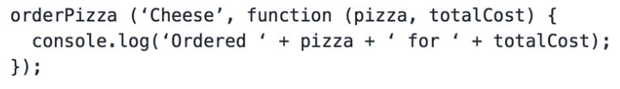
Functions in ES6
Arrow Functions
Normal function syntax is much more painful in other circumstances
When used as a parameter to another function
Particularly as callback functions
And even more so when they are anonymous

Slide 10
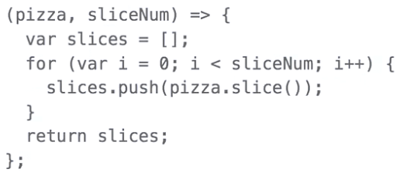
Functions in ES6
Arrow Functions
Remove the function keyword
Remove the function name
Place the parameter list in parentheses
Introduce the => fat arrow notation to point to the function body
Give it a name to call it normally, by assigning it to a variable if desirable

Slide 11

Functions in ES6
Arrow Functions
Arrow function syntax is much cleaner
When used as a parameter to another function
Particularly as callback functions
And even more so when they are anonymous

Slide 12
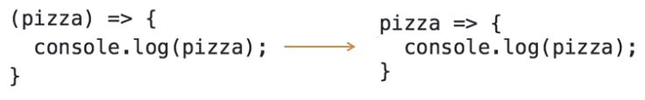
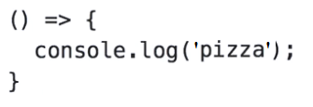
Functions in ES6
Arrow Function Characteristics
Can remove the parentheses when just a single argument
Many in Node.js community consider this a Bad Practice
If no arguments, must have parentheses

Slide 13
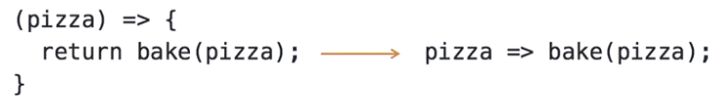
Functions in ES6
Arrow Function Characteristics
One line functions may have very simple syntax
The curly braces ( {} ) may be removed
A return statement may also be removed
What is returned may be any evaluated JavaScript expression, or even a literal

Slide 14
Functions in ES6
Programming Exercise03_01_01 – Step 2
Converting ES5 Functions to ES6 Arrow Functions

Slide 15
Lexical Scope
Lexical Scope in JavaScript
JS does not have block (local) scope
JS has only global and function scope
JS has lexical scope
A new scope is created only when you create a new function
The scope of variables is defined by their position in source code
Starts at the innermost scope
Searches outwards until it finds the variable for which it was looking
For a normal var, arrow functions behave the same

Slide 16
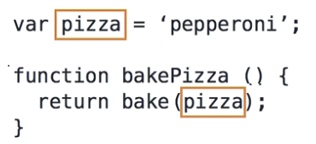
Lexical Scope
Lexical Scope in JavaScript
Here is an example of lexical scoping
pizza is a variable declared outside the function
pizza is lexically scoped, available inside the regular function
Scope is defined by its physical location in code

Slide 17
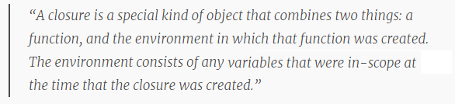
Lexical Scope
Closure in JavaScript
With regular variables, closure is around the caller, then follows the rules of lexical scoping
The this reference does not behave like a regular variable
It maintains a different closure

Slide 18
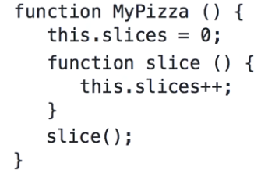

Lexical Scope
Closure in JavaScript
An example of a function inside a constructor function
this is a reference to the current object
It is located in the context of the outer function
Each function that is executed has its own context
JavaScript loses scope of this inside a function that is contained inside of another function
In regular functions, this closes over the parent, in this case the outer function, not the caller, not lexically scoped

Slide 19
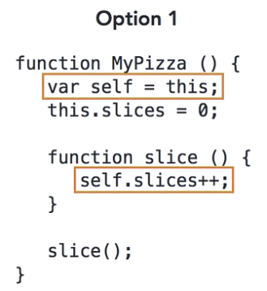
Lexical Scope
this Workaround in Regular Functions
Store the reference to this in a regular variable
Under regular function lexical scope, this is not available in the inner function
But the regular variable holding the reference as a value is available

Slide 20
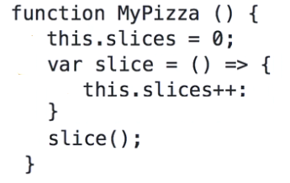

Lexical Scope
this in Arrow Functions
An arrow function inside a constructor function
Arrow functions do not lose the scope of this
No workaround is required, no need to put the this reference inside a regular variable
Arrow functions set this to the lexical scope

Slide 21
Lexical Scope
Hoisting in JavaScript
Affects variables that have a var declaration
Hoisting means that all var declarations are moved to the top of the current scope
Either global or function scope
Hoisting is done for both regular and arrow functions assigned in a var declaration
Behavior of the hoist is different with each
With regular functions, the whole body of the function is moved to the top with the declaration
With arrow functions, the parameter list, fat arrow and body are not moved with the declaration

Slide 22

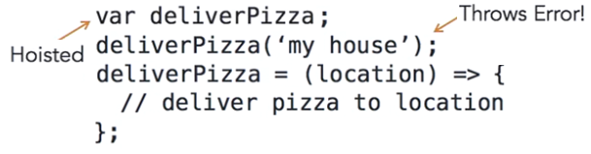
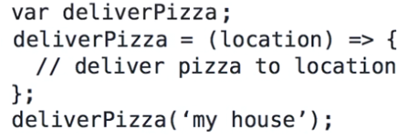
Lexical Scope
Hoisting in JavaScript
Here is your code as written
Here is how the interpreter hoists it, deliverPizza() is undefined on call
The solution, move the variable assignment above the function call

Slide 23
Lexical Scope
Programming Exercise03_01_01 – Step 3
ES6 Arrow Functions with Scope Modifications

Slide 24
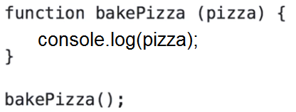
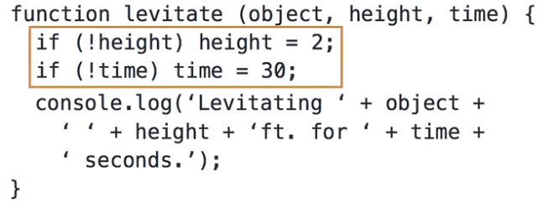
Default Parameters
Undefined Function Arguments
By default, arguments not supplied to a function when called are set to undefined
ES5 - must program defensively to correct, or to implement different ways to call
undefined

Slide 25
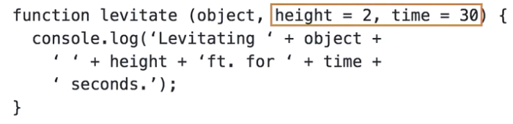
Default Parameters
Default Function Parameters in ES6
ES6 allows us to move this functionality cleanly into the function signature
If called with all parameters, default is not applied
If called with the first two, only the third is applied
Care is required to make the use of the default always be the last ones

Slide 26
Default Parameters
Programming Exercise03_01_01 – Step 4
Making Use of Default Parameters in ES6

Slide 27
Ellipsis Operator
Rest Parameters
Used to declare a variable number of parameters to a function
This is a feature of many other programming languages
In ES6, the ellipsis operator serves other tasks as well, upcoming
Collects function arguments that are passed into an array object

Slide 28
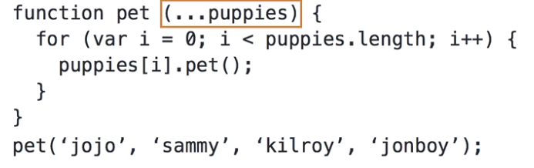
Ellipsis Operator
Rest Parameters
Indicated by an ellipsis before a variable identifier
The ellipsis operator must touch against the identifier
Must be the last parameter in the parameter list
There can be only one rest parameter per function
Default parameters do not work with rest parameters
Each argument is passed separately but translates to an array when received

Slide 29
Ellipsis Operator
Programming Exercise03_01_01 – Step 5
Making Use of Rest Parameters in ES6

Slide 30
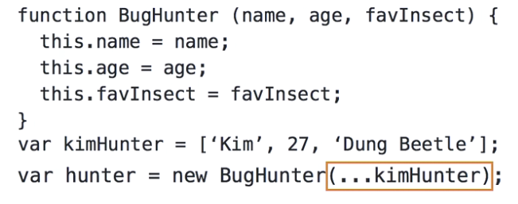
Ellipsis Operator
Spread Syntax
In many ways the opposite of rest parameters, which gather values into a single array argument
The spread syntax takes an iterable object like an array and spreads it out to multiple single variables
In ES5 we would have to call the constructor with 3 indexed array elements

Slide 31
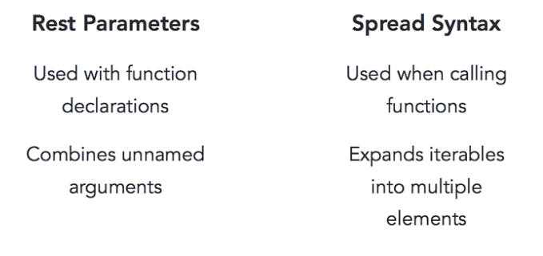
Ellipsis Operator
Rest Parameter vs. Spread Syntax

Slide 32
Ellipsis Operator
Programming Exercise03_01_01 – Step 6
Making Use of Spread Syntax in ES6

Slide 33
Introducing Classes
Javascript and Object-Oriented Programming
JS has always been different than traditional OOP languages like Java, C++, and C#
ES5 does not have an explicit data type called a class
In other OOP languages, a class is a blueprint that defines objects
Particularly, defines the object properties and methods
Objects are constructed from this blueprint
Constructing an object from a class is referred to as instantiating the object

Slide 34
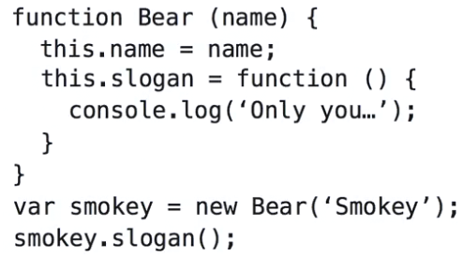
Introducing Classes
ES5 Objects
ES5 JavaScript uses functions to define objects
The this keyword is used to define the properties and methods
The new keyword is used to construct an object using the function
The class syntax does nothing different, it is syntactic sugar, but cleaner reading and more compatible
Not truly object-oriented, although classes can be extended
There is no true inheritance implemented

Slide 35
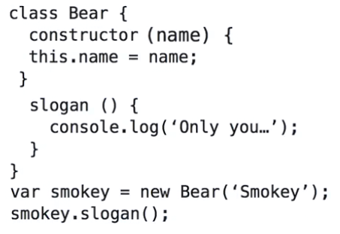
Introducing Classes
ES6 Classes
ES6 JavaScript uses classes to define objects
The class keyword is used to define a class
The identifier is optional and a class may be anonymous if assigned to a variable
It is not a function, there is now a constructor function which is called when the new keyword is used
Methods are defined without the function keyword, no this keyword is used to define methods
To convert, move function arguments to the constructor

Slide 36
Introducing Classes
Programming Exercise03_01_01 – Step 7
Making Use of Classes in ES6

